Slide 1
Battle of the Neighborhood Capstone Project
By
RV Data Analytics

Slide 2
Background and Problem Statement
Joy Foods Pvt Limited has been successfully running a chain of high quality Indian restaurants in the US. They wish to tap in to the growing market in Canada and have identified Toronto to be their first location for opening a new Indian restaurant
The restaurant business in Toronto is quite competitive and location is key to success of the business
Hence, the company has hired RV Data Analytics firm to analyze the Indian restaurants in Toronto
The objective of this study is to recommend the best location to open a high quality Indian restaurant in Toronto

Slide 3
Data Required
For performing this analysis, RV Data Analytics will use the following data:
Description of Toronto boroughs and neighborhoods from the website
(https://en.wikipedia.org/wiki/List_of_postal_codes_of_Canada:_M)’)
Latitude and longitude of the neighborhoods using Geocoder
Details of Indian Restaurants in each neighborhood using Foursquare API

Slide 4
Methodology
Collect borough, neighborhood, latitude, longitude data Using FourSquare API, find all venues for each neighbourhood
Filter venues for Indian Restaurants.
Determine total number of Indian restaurants in Toronto and count them by borough
Find rating , tips and like count for each Indian Restaurants using FourSquare API
Identify best Indian restaurant in Toronto
Analyze ratings data by borough
Provide recommendation for best location for opening a new Indian restaurant

Slide 5
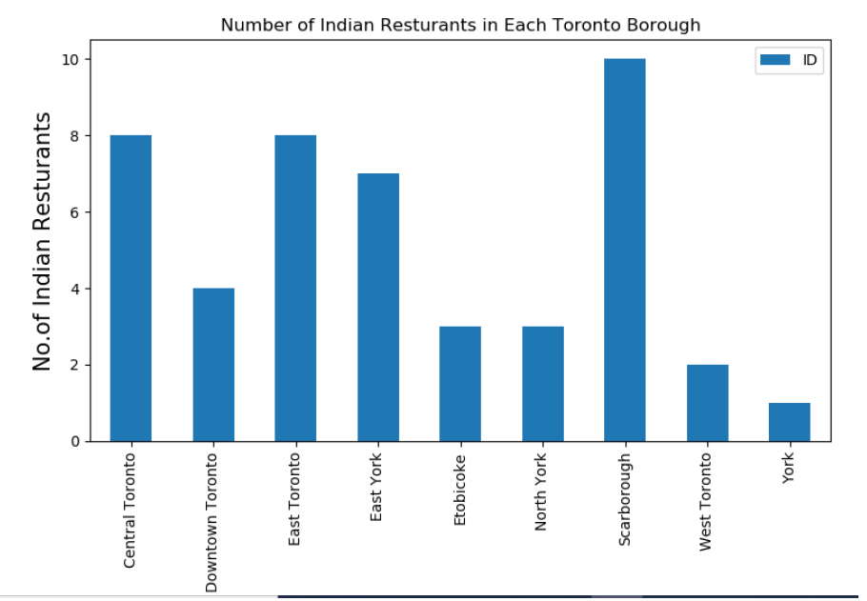
Results and Discussion
46 Indian restaurants in Toronto spread across the 9 boroughs
Scarborough has the highest number of Indian restaurants with 10

Slide 6
Results and Discussion
The best Indian restaurant in the city of Toronto is Banajara Indian Cuisine in Downtown Toronto.
It has the maximum ratings (8.9), likes (145), and tips (75) among all the Indian restaurants.

Slide 7
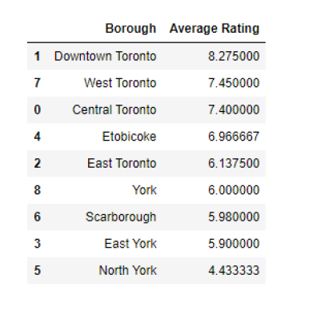
Results and Discussion
Downtown Toronto has the highest average rating of 8.3
Despite having maximum number of Indian restaurants, the average rating of Indian restaurants in Scarborough is less than 6.0

Slide 8
Conclusion
The Indian restaurants in the city of Toronto were analyzed. There are a total of 46 restaurants spread across the 9 boroughs with Scarborough having the most with 10
However, Downtown Toronto has the highest average rating of Indian restaurants amongst all boroughs
Scarborough fares fairly poorly with an average rating of less than 6.0
Hence, Scarborough is recommended as a top location for opening a new high quality Indian restaurant

